Slide 1
Neuroscience
Cells, signals, systems, and brain networks
Takeaway: Neuroscience links behavior to brain and body processes without overclaiming what a diagram can prove.
Notes:
Instructor use
- Takeaway-first and lecture mode: slides are anchors; the explanation lives here.
- Images are for orientation, not proof of causation.
Distribution safeguard
- If students will not receive speaker notes, publish a companion study note with the concept-block notes.

Slide 2
How today is organized
Start with the big map of the nervous system
Add signal direction: afferent and efferent
Zoom in: neurons, glia, action potentials, synapses
Zoom out: autonomic regulation and brain structures
End with methods and limits
Takeaway: We will move from systems to cells to brain regions, then back to how we know what we know.
Notes:
Teaching note
- Repeat the organizing question: input, processing, output, regulation.
- Maps are simplifications used for learning and communication.

Slide 3
The nervous system map
Notes:
What is next
- A clean map of CNS and PNS, then direction of signaling.
Why this matters
- Most later confusion comes from losing track of divisions and direction.

Slide 4
What the nervous system does
Detects information
Processes and integrates
Produces responses
Learns and adapts
Takeaway: The nervous system senses, decides, acts, and adapts.
Notes:
Example
- Touch a hot pan: sensory input, spinal processing, motor output, learning to avoid.
Common confusion
- The spinal cord and peripheral pathways also matter.

Slide 5
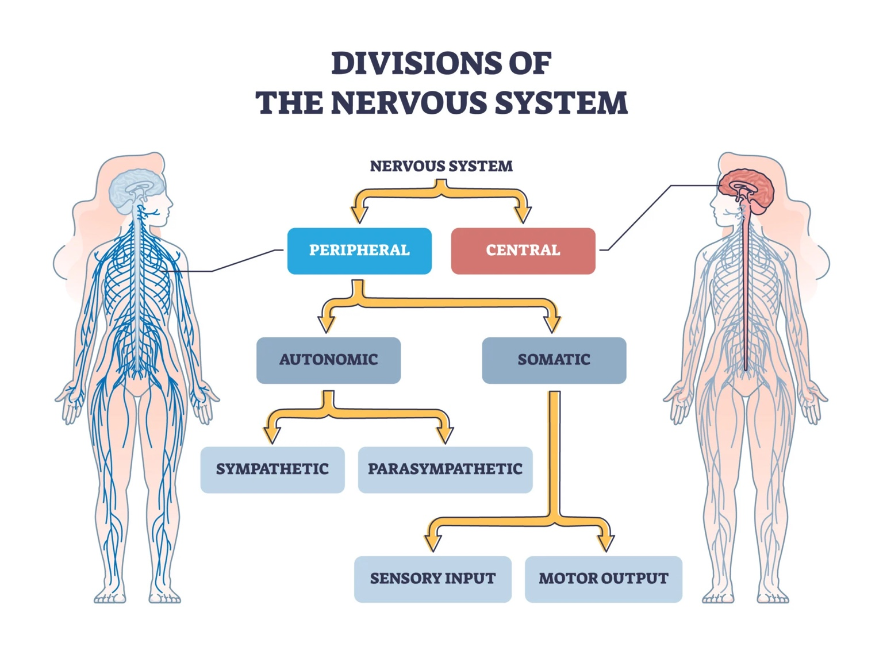
Divisions of the nervous system
Takeaway: Divisions help you locate where signals travel and what kinds of actions they control.
Notes:
Caption
- Hierarchical map of the nervous system.
Accuracy note
- Somatic includes voluntary movement and reflex loops.
- Autonomic is often automatic, but not fully beyond influence.

Slide 6
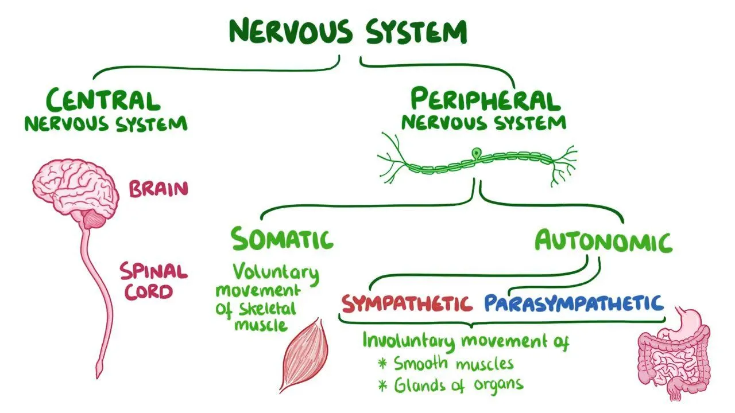
Nervous system map in plain language
Takeaway: CNS processes and integrates; PNS carries signals between CNS and body.
Notes:
Caption
- Student-friendly map of CNS/PNS and somatic/autonomic.
Accuracy guardrails
- Autonomic is not a strict on-off switch.
- Somatic is not always voluntary.

Slide 7
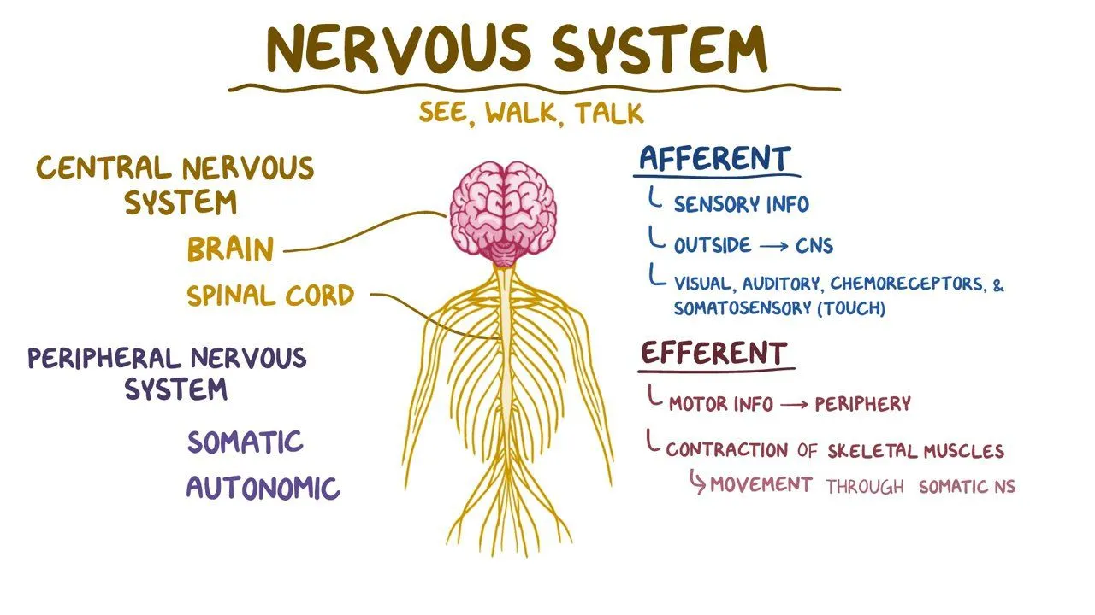
Afferent and efferent
Takeaway: Direction matters: afferent goes to the CNS, efferent goes to the body.
Notes:
Caption
- Afferent versus efferent as direction labels.
Accuracy guardrail
- Sensory input includes external and visceral sensory signals.

Slide 8
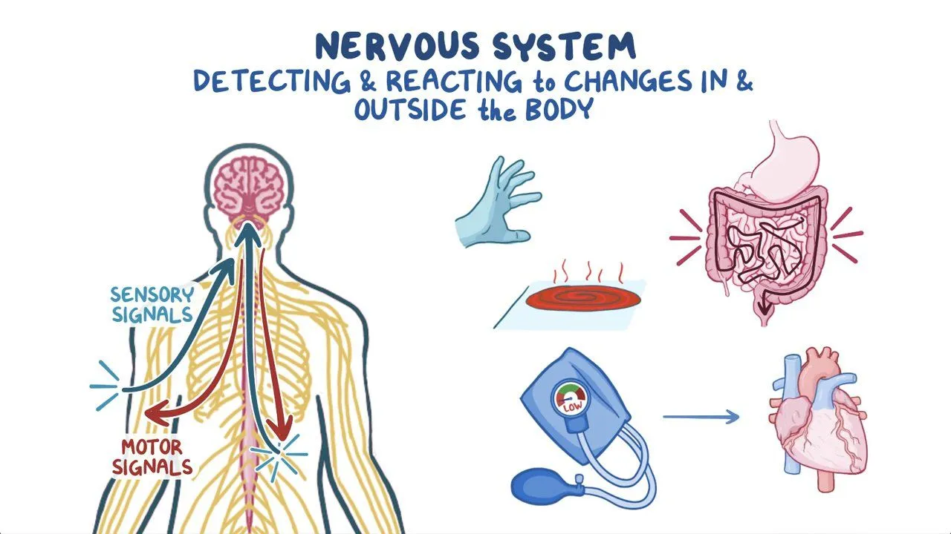
Sensory input and motor output loop
Takeaway: Behavior is a loop: input, processing, output, and ongoing adjustment.
Notes:
Teaching notes
- Use one scenario: hot surface, withdraw, recovery.
- Name where processing happens: spinal cord for reflex, cortex for report.

Slide 9
Engage: Afferent or efferent
Classify each as afferent or efferent:
Touching a hot mug and feeling heat
Pulling your hand away
Feeling your heart pounding
Sweating
Two minutes. Write four labels.
Takeaway: A strong answer labels direction correctly and can explain one example in plain language.
Notes:
Intended answers
- Afferent: feeling heat; feeling heart pounding.
- Efferent: pulling hand away; sweating.
Common wrong answers
- Calling sweating sensory because it is felt.
- Treating the terms as system names.

Slide 10
Peripheral nervous system in detail
Notes:
What is next
- Somatic versus autonomic; sympathetic versus parasympathetic.
Why this matters
- Used constantly for emotion, stress, and health.

Slide 11
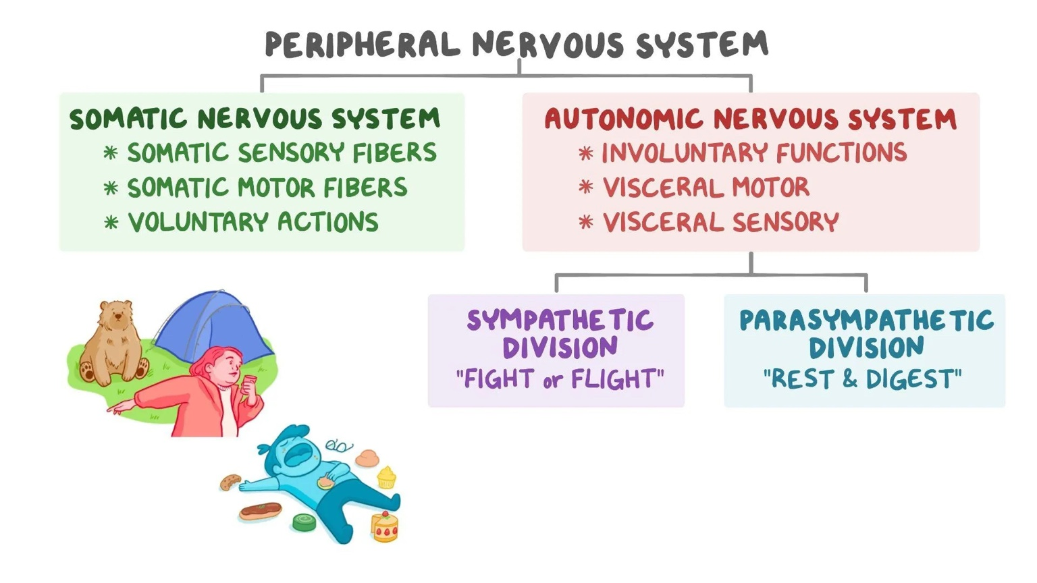
Somatic versus autonomic
Takeaway: The PNS carries signals through somatic pathways and autonomic regulation pathways.
Notes:
Accuracy guardrails
- Somatic includes reflexes.
- Autonomic is influenced by context and learning.
- Sympathetic and parasympathetic can co-occur.

Slide 12
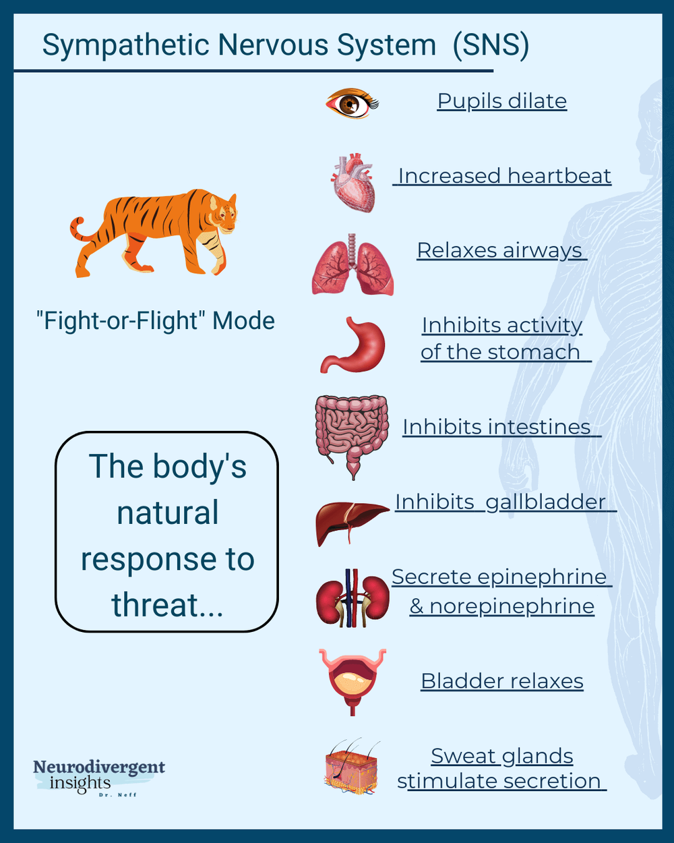
Sympathetic nervous system
Takeaway: Sympathetic activity supports rapid action by shifting resources toward immediate demands.
Notes:
Accuracy guardrail
- Avoid “sympathetic equals stress equals bad.” Emphasize flexibility and context.

Slide 13
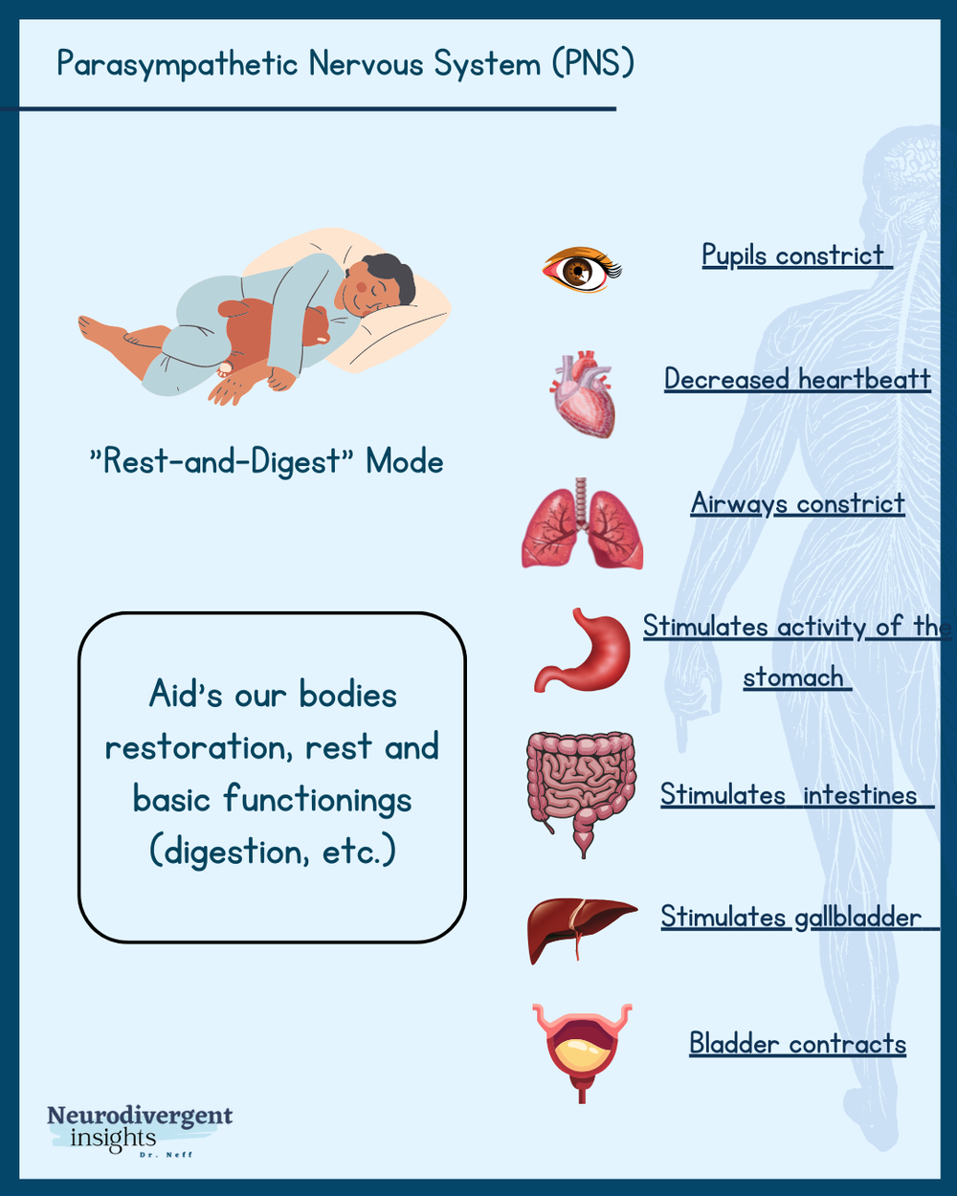
Parasympathetic nervous system
Takeaway: Parasympathetic activity supports restoration and digestion as demands pass.
Notes:
Accuracy guardrail
- Avoid a strict binary. Emphasize dynamic balance and timing.

Slide 14
Engage: Which branch is more active
For each situation, name which branch is more active and why:
Sprinting to catch a bus
Eating a meal after a long day
Giving a speech
Falling asleep
Three minutes. Pair-share, then report one example.
Takeaway: A strong answer connects the scenario to a body goal, not to a slogan.
Notes:
Intended answers
- Sprinting and speech: sympathetic more active.
- Eating and sleep onset: parasympathetic more active.
Common wrong answers
- Treating these as strict on-off switches.

Slide 15
Cells and signaling
Notes:
What is next
- Neurons and glia; electrical within neurons; chemical between neurons.
Why this matters
- Drugs, learning, and disorders depend on synapses and communication.

Slide 16
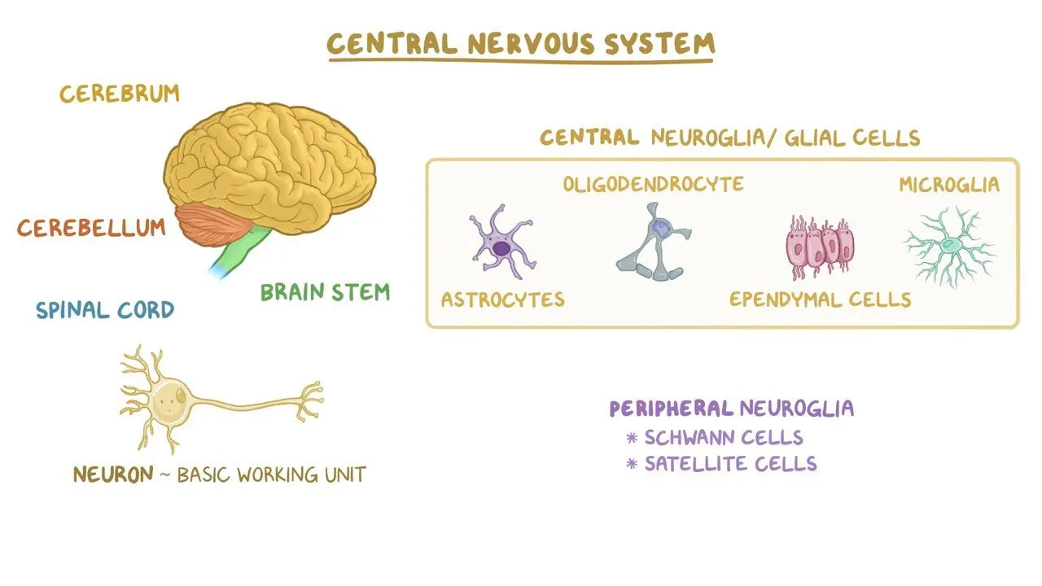
Neurons and glia
Takeaway: Glial cells are active partners in neural function, not passive filler.
Notes:
Key points
- Oligodendrocytes myelinate CNS axons; Schwann cells myelinate PNS axons.
- Microglia play immune-like roles.

Slide 17
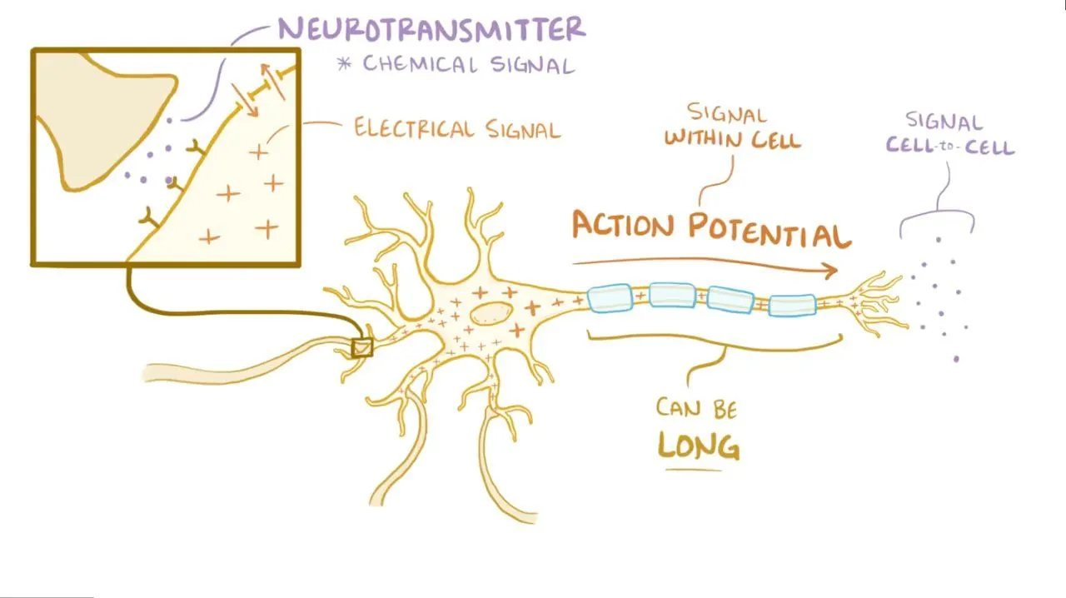
Electrical within neurons, chemical between neurons
Takeaway: Neural communication uses electrical signaling within cells and chemical signaling between cells.
Notes:
Teaching move
- Keep it conceptual here, then go detailed on synapses next.

Slide 18
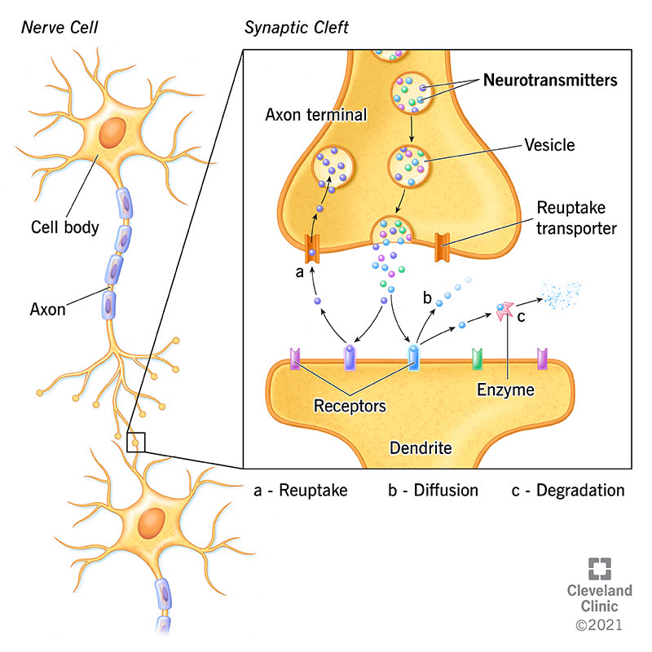
Synapse and neurotransmitter signaling
Takeaway: Synapses translate electrical signals into chemical signals and shape what happens next.
Notes:
Accuracy guardrail
- Neurotransmitters are not one-chemical equals one emotion.
- Effects depend on receptors, pathways, and context.

Slide 19
Engage: Where would a drug act
A medication increases neurotransmitter levels in the synaptic cleft.
Which mechanism is most likely affected:
Reuptake
Breakdown by enzymes
Vesicle release
Two minutes. Vote, then write one sentence justification.
Takeaway: A strong answer names one mechanism and links it to neurotransmitter clearance.
Notes:
Intended answer
- Reuptake inhibition is common, but emphasize reasoning from clearance.
Common wrong answer
- Explaining it via action potentials rather than synaptic clearance.

Slide 20
Brain regions and networks
Notes:
What is next
- Forebrain, midbrain, hindbrain; then landmarks, lobes, limbic structures.
Why this matters
- Students need network cautions from day one.

Slide 21
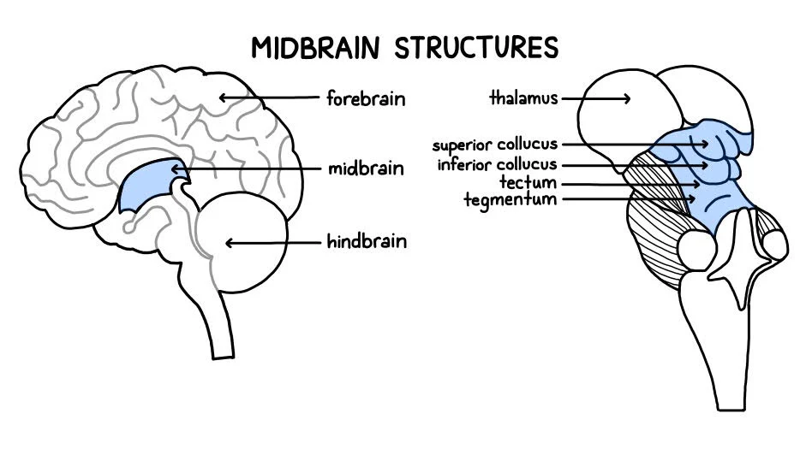
Forebrain, midbrain, hindbrain orientation
Takeaway: Brain regions are connected; labels help orientation, not perfect boundaries.
Notes:
Accuracy guardrail
- Thalamus is typically forebrain, not midbrain.

Slide 22
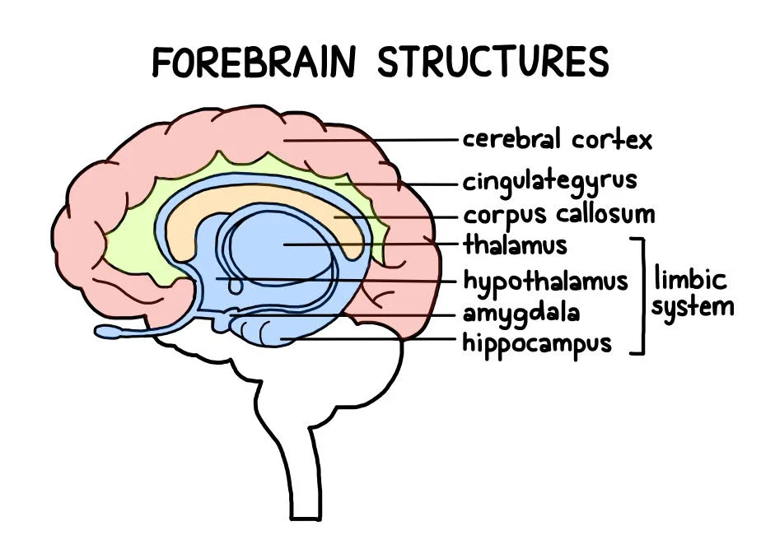
Forebrain structures
Takeaway: Forebrain structures support complex cognition and connect emotion, memory, and body regulation.
Notes:
Accuracy guardrail
- “Limbic system” is a useful shorthand, not a crisp anatomical unit.

Slide 23
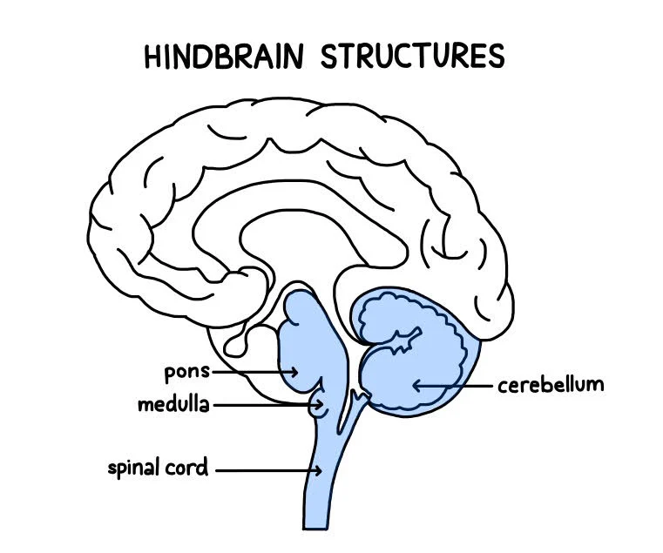
Hindbrain structures
Takeaway: Hindbrain structures support vital functions and coordinated movement.
Notes:
Teaching notes
- Brainstem: breathing, heart rate, arousal.
- Cerebellum: coordination, timing, error correction.

Slide 24
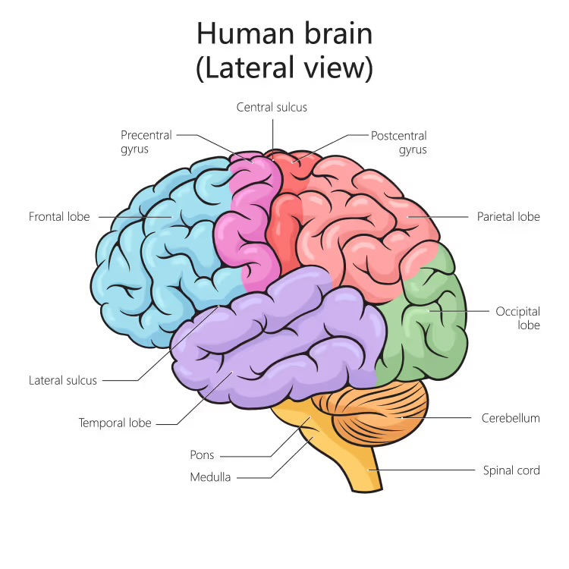
Brain landmarks for orientation
Takeaway: Landmarks help you locate where functions tend to cluster, even though functions rely on networks.
Notes:
Teaching move
- Central sulcus as an anchor between motor and somatosensory regions.

Slide 25
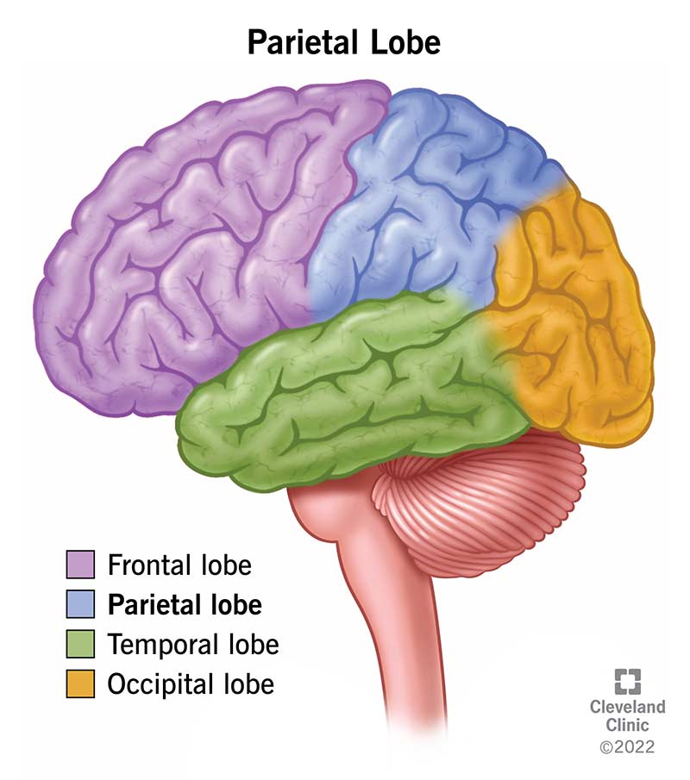
Cerebral cortex lobes
Takeaway: Lobes are a rough map; most functions depend on networks across lobes.
Notes:
Teaching notes
- One tendency per lobe in speech, then immediately state the network caution.

Slide 26
Engage: Which lobe would you check first
For each function, write the lobe you would check first:
Planning and self-control
Touch and body position
Hearing and language comprehension
Visual processing
Two minutes. Write four lobes.
Takeaway: A strong answer gives a reasonable first guess and remembers that networks matter.
Notes:
Intended answers
- Frontal, parietal, temporal, occipital.
Common wrong answers
- Treating first guess as only location.

Slide 27
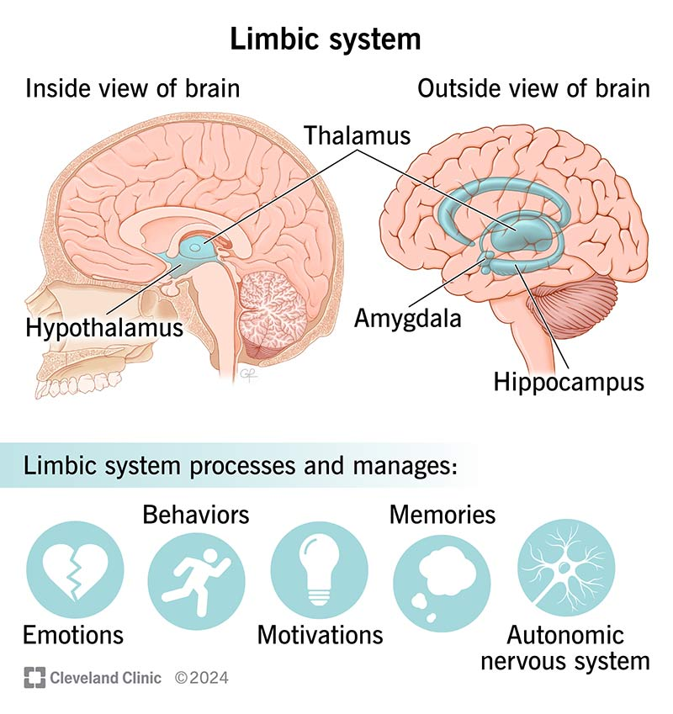
Limbic system overview
Takeaway: Limbic network ideas link emotion, memory, motivation, and body regulation.
Notes:
Accuracy guardrail
- Present as a network concept.

Slide 28
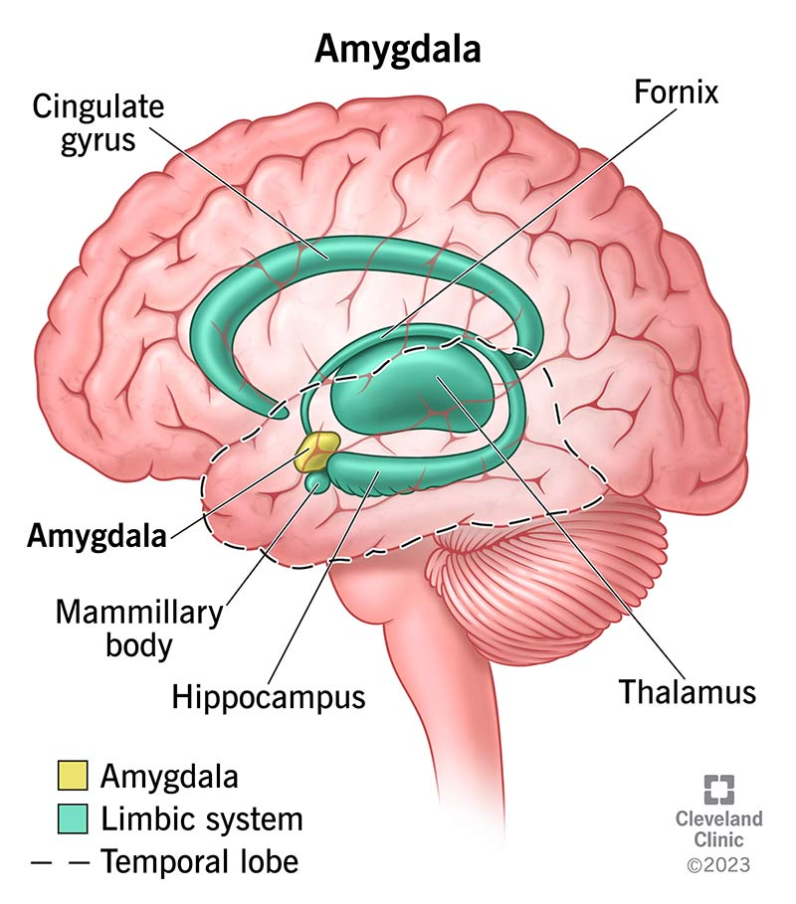
Amygdala in context
Takeaway: The amygdala helps prioritize important stimuli, including potential threats.
Notes:
Accuracy guardrail
- Avoid “amygdala equals fear.” Frame salience and relevance.

Slide 29
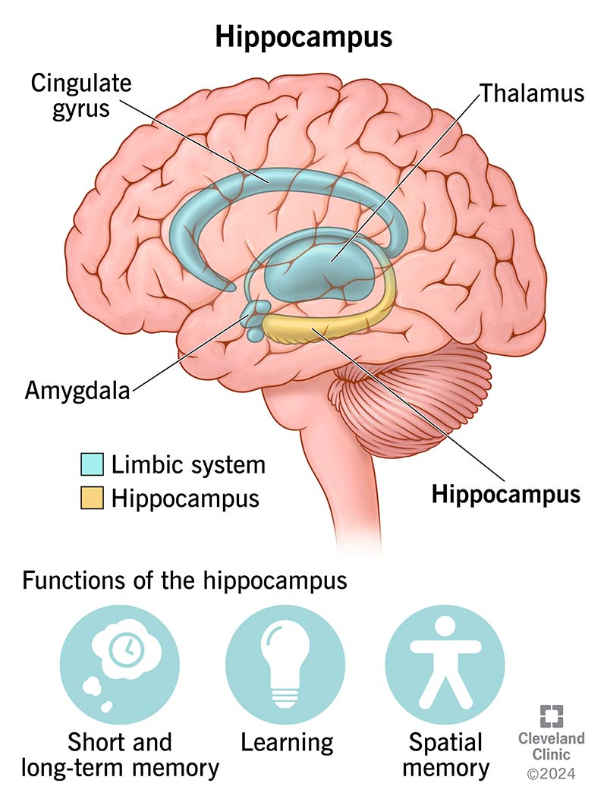
Hippocampus and memory formation
Takeaway: The hippocampus supports forming new episodic memories and linking experiences to context.
Notes:
Accuracy guardrail
- Long-term memory storage is distributed across cortex.

Slide 30
Engage: Amygdala and hippocampus together
A student remembers where a scary incident happened and feels fear walking by that spot.
In one sentence, explain how the amygdala and hippocampus could both be involved.
Two minutes. Write one sentence.
Takeaway: A strong answer links context to hippocampus and threat relevance to amygdala.
Notes:
Good answer features
- Context/location: hippocampus.
- Threat relevance/salience: amygdala.
Common wrong answer
- “Amygdala stores fear memories.” Correct with distributed storage and networks.

Slide 31
Methods and limits
Notes:
What is next
- Method limits and how to interpret brain claims.
Why this matters
- Prevent treating images as proof of causation.

Slide 32
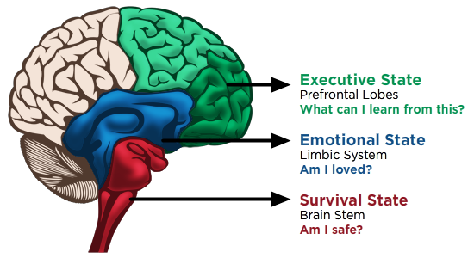
Evaluate an oversimplification
Takeaway: Simple one-region “state” maps are useful metaphors but misleading as anatomy.
Notes:
Use
- Treat as misconception check.
What to critique
- Functions are distributed across networks; executive control is not only PFC.

Slide 33
How we study the brain
Lesions and case studies
EEG and ERPs
fMRI and PET
Stimulation methods
Takeaway: Brain methods trade off timing, location, invasiveness, and causal inference.
Notes:
Key distinctions
- EEG: timing, weaker location.
- fMRI: location, slower and often correlational.
- Lesions/stimulation: closer to causality, but constrained.

Slide 34
Engage: What would you ask first
A headline says “This brain region causes anxiety.”
Write one question you would ask before believing it.
Two minutes. Write one sentence.
Takeaway: A strong question asks about method, inference type, and alternative explanations.
Notes:
Good questions
- What method was used.
- Correlational or causal.
- Sample and context.

Slide 35
Plasticity and wrap
Notes:
What is next
- Plasticity as a bridge to learning, memory, development, and disorders.

Slide 36
Neuroplasticity
Brains change with experience
Connections strengthen and weaken
Development reshapes networks
Injury can reorganize function
Takeaway: Experience changes the brain through plasticity across the lifespan.
Notes:
Guardrails
- Plasticity is real, but not unlimited.
- Timing and constraints matter.

Slide 37
Synthesis
Systems map where signals travel
Cells explain how signals happen
Brain regions orient likely function clusters
Methods limit justified conclusions
Takeaway: Neuroscience explains behavior by combining levels of analysis and respecting evidence limits.
Notes:
Teaching move
- Repeat the throughline: map, mechanism, meaning, method.

Slide 38
Exit prompt
Write one takeaway you will remember next week and one question you want answered next class.
Two minutes. Write two lines.
Takeaway: A strong exit response is specific enough to guide study and specific enough to be answerable.
Notes:
Debrief
- Cluster questions: systems, signaling, brain regions, methods.

Slide 39
Resources
In class: Lobe map for quick orientation
In class: Synapse diagram for drug mechanism reasoning
In class: Autonomic branch diagrams for scenario practice
Optional: Practice set on CNS vs PNS and afferent vs efferent
Optional: Short review on action potentials vs synaptic transmission
Takeaway: Use resources to practice explanations, not to memorize labels without meaning.
Notes:
In-class workflow
- Keep the in-class list short and use it intentionally.
- If a link fails, use the image already in the deck and narrate accessibly.

